Slide 1

ANTOFAGASTA RACE PREVIEW
Elite Analysis · July 3 – 5, 2026
USA Triathlon High Performance

Slide 2
Race Week Schedule
Antofagasta
July 3 – 5, 2026 • Balneario Municipal, Av República de Croacia, Antofagasta (CLT, UTC-4)
Fri • July 3
Sat • July 4
Sun • July 5
Familiarization & Briefing
CHAMPIONSHIP RACE DAY
Para + AG + Relay
9:00 | Elite / Junior Cycling familiarization
9:30 | Elite / Junior Swimming familiarization
All day | Para Triathlon Cycling + Swim familiarizations
13:00 – 18:00 | Age-Group Registration / Kit delivery — ENJOY Antofagasta
16:00 – 16:45 | ★ Elite / Junior briefing — ENJOY Antofagasta
16:45 – 18:15 | Elite / Junior Registration / Kit delivery
5:30 | ★ ALL ★ Athlete Room Opens
AM | ★ Junior Women Championship — Sprint
AM | ★ Junior Men Championship — Sprint
9:30 | ★ Elite / U23 Women Championship Transition Opens
10:15 | ★ Elite / U23 Women Championship — Start
11:30 | ★ Elite / U23 Men Championship — Transition Opens
12:30 | ★ Elite / U23 Men Championship — Start
16:00 – 16:45 | Para Triathlon Championship Briefing
AM | ★ Para Triathlon Championship — Sprint
AM | Youth Women Championship — Super Sprint
AM | Youth Men Championship — Super Sprint
Mid-day | Age-Group Championship — Standard
14:00 | 2×2 Mixed Relay — Elite + Juniors – Transition Opens
14:40 | 2×2 Mixed Relay — Elite + Juniors – Start
16:20 | 2×2 Mixed Relay — Elite + Juniors – Medal Ceremony
Times Balneario Municipal, Av República de Croacia, Antofagasta (CLT, UTC-4).

Slide 3
Key Course Differentiators
Antofagasta
ANTOFAGASTA
COURSE AT A GLANCE
First-time Americas Triathlon & Para Championships host. Antofagasta sits on Chile's northern Pacific coast between the Atacama desert. Expect a cool, dry, light-wind race in Southern Hemisphere winter (avg high 18 °C). Elite/U23 athletes contest a Standard race on Saturday with a bike circuit slightly longer than typical (8 × 5.414 km = 43.3 km), and the swim uses a distinctive beach-exit-and-re-entry between laps. Expect a wetsuit race in 14–16 °C ocean water.
Swim:
1.5 km – 2 laps × 750 m
Bike:
43.3 km – 8 laps × 5.414 km
Run:
10 km – 4 laps × 2.5 km
Format:
Standard Triathlon (Elite)
COURSE FEATURES
Bike Laps:
8
Run Laps:
4
• Pacific Ocean swim (~14–16 °C). Standard format swims 2 laps with a beach exit + re-entry between them with almost 100% chance of a wetsuit-legal swim.
QUICK LINKS
• Bike: 8 × 5.414 km laps (43.3 km — ~3 km longer than standard 40 km) along Av República de Croacia ↔ Av Ejército. Flat, fast, some potential exposure to ocean breezes.
Current Race Info:
Race Info | 2026 Americas Triathlon & Para Championships Antofagasta
• Run: 4 × 2.5 km laps on Av Grecia coastal road. Flat asphalt out-and-back. Potential for fast splits given the cool conditions and terrain.
• First-ever AT Championships in Antofagasta. No prior race-day data;

Slide 4
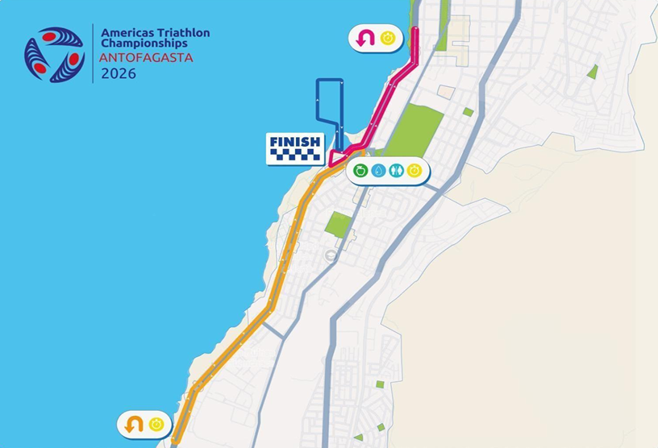
Course Profile & Map
Antofagasta
2026 Course
Discipline | Distance | Laps | Terrain / Notes
Swim | 1.5 km | 2 | Ocean swim. Beach start with early protection. Quick left turn after exiting harbor. Water looks generally calm, but expect for it to be wetsuit legal.
Bike | 43.3 km | 8 | Pancake flat bike course. Slightly longer than standard distance (3km extra). 8 laps on simple out and back stretch.
Run | 10 km | 4 | Pancake flat run course on asphalt road. Cool temperatures and flat conditions should allow for fast conditions.

Slide 5
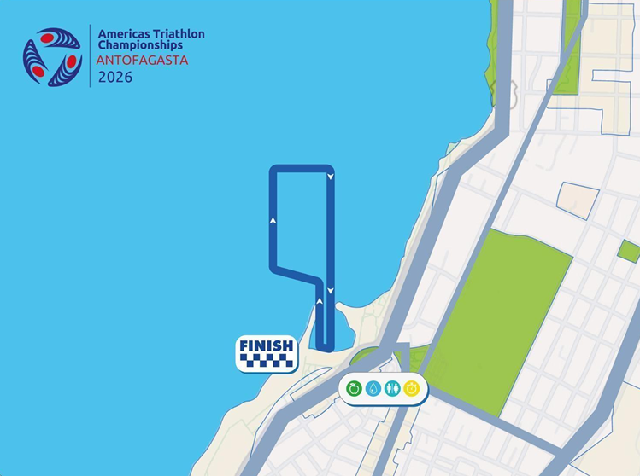
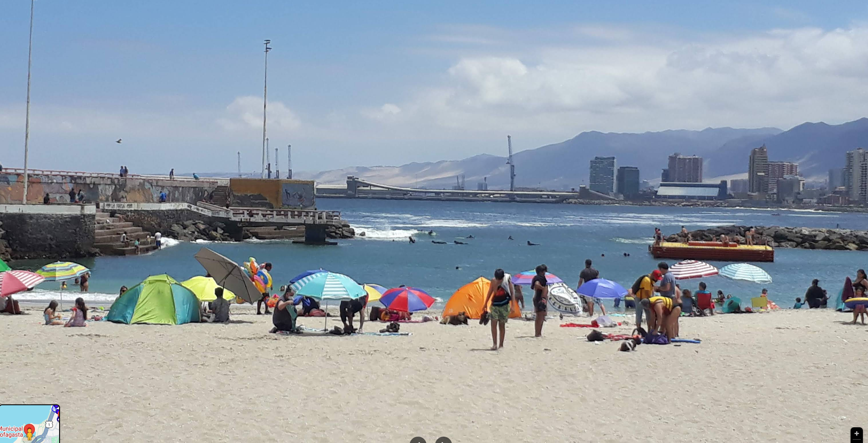
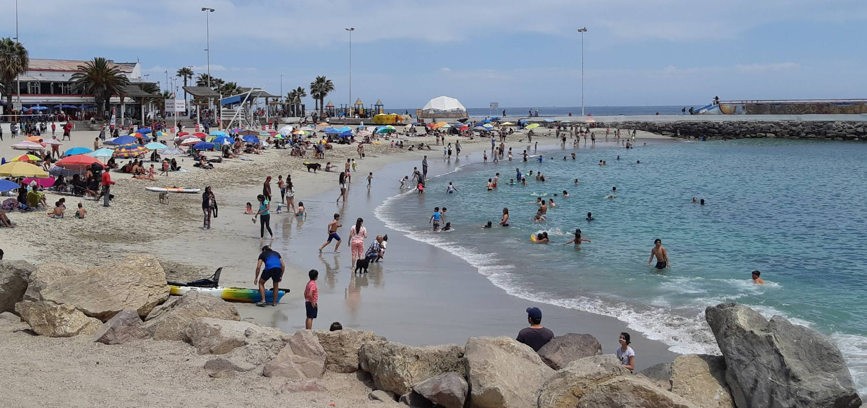
Swim Course Profile
Antofagasta
1.5 km • 2 × 750 m
Open ocean — Pacific (Humboldt Current)
Distance
Layout
Start
1.5 km
Pacific Ocean
Beach start
[Drop swim course map here] Save the organiser map as: ppt files/support/antofagasta_swim_course.png It will be embedded automatically on the next run.
Water Temp
Wetsuit
Lap Count
15.7 °C (7-yr avg)
Wetsuit mandatory
2
Tactical Notes
• Pacific Ocean swim directly off the Balneario Municipal beach. Some exposed open water.
• Buoy-marked rectangular course, counter-clockwise direction; Standard distance BEACH EXIT AND RE-ENTRY between laps/
• July is winter in Southern Hemisphere, water typically 14–16 °C
Source: Americas Triathlon NF Information Package — Antofagasta 4–5 Jul 2026

Slide 6
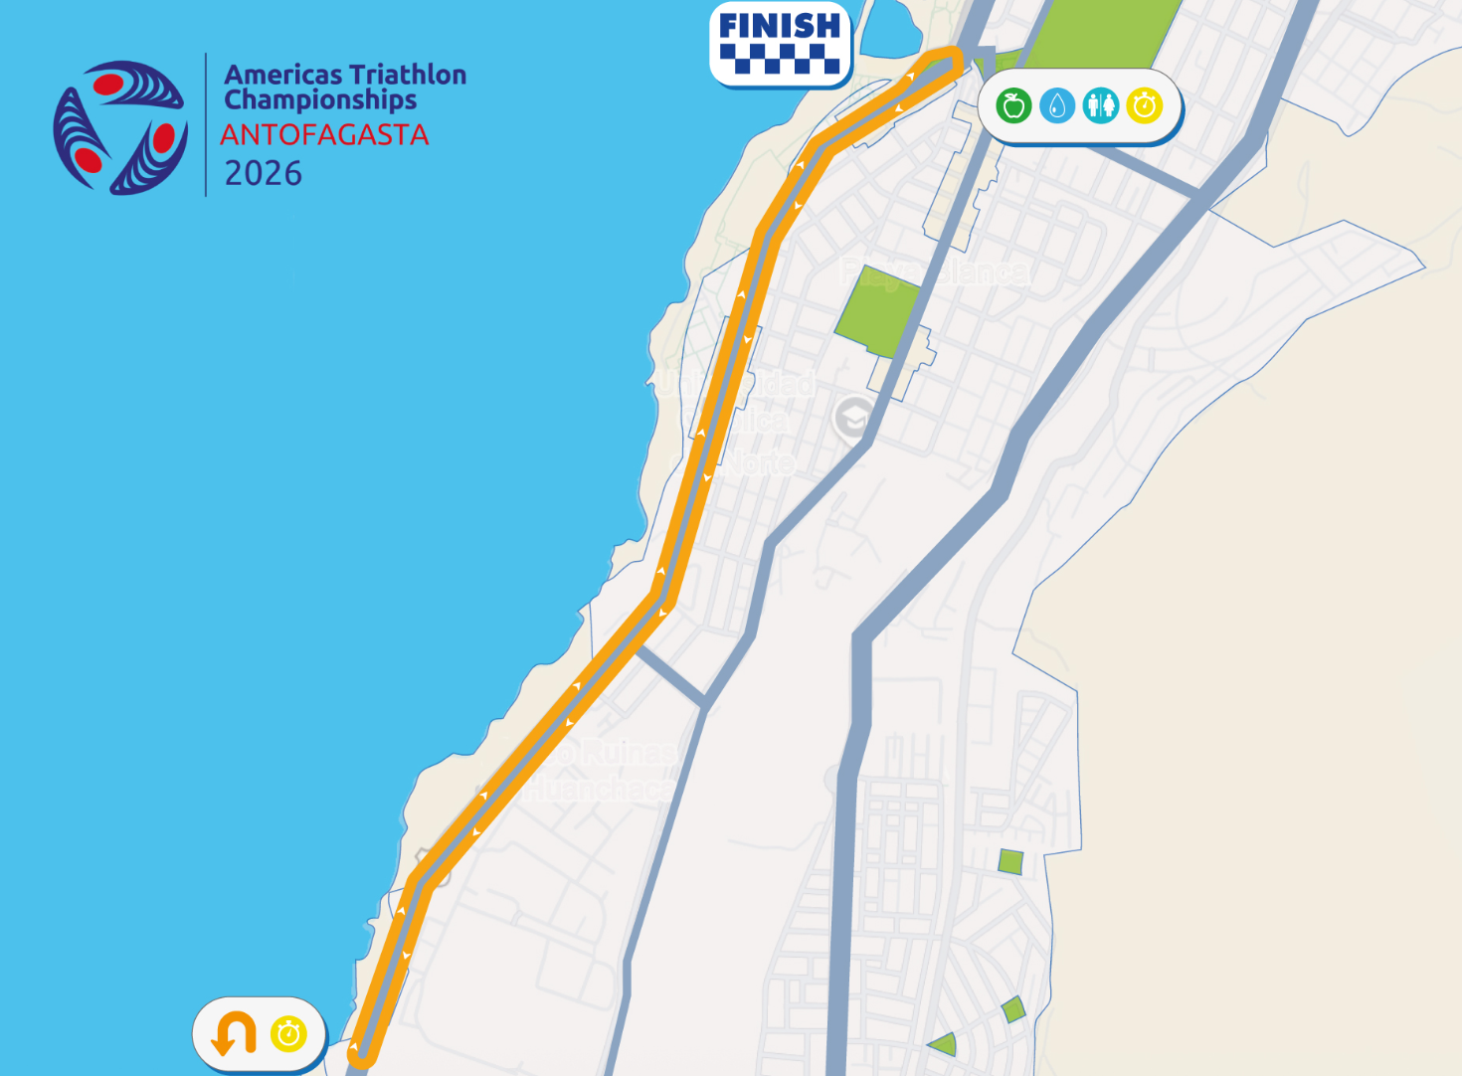
Bike Course Profile
Antofagasta
43.3 km • 8 × 5.414 km loops
Closed coastal urban — Av República de Croacia ↔ Av Ejército
[Drop course map here] Save the organiser course map as: ppt files/support/antofagasta_bike_course.png It will be embedded automatically on the next run.
Elevation / Lap
Total Climb
Avg Grade
Flat (22m / lap)
22m
0.1%
Max Climb Grade
Wind
Loops
—
Coastal Pacific
8 × 5.414 km
Tactical Implications
• 8 × 5.414 km loops = 43.3 km (~3 km longer than a typical 40 km Olympic bike)
Source: Americas Triathlon NF Information Package — Antofagasta 4–5 Jul 2026
• Out-and-back beach corridor
• Pacific coastal exposure. Potential for some wind
• Closed urban circuit on a wide multi-lane coastal avenue — fast, low-technical, hammer-friendly
• 8 laps = 8 transit passes through the Plaza Rotonda turnaround — bike-handling premium on the lap point
Flat course — published profile shows no significant climbs. No elevation chart synthesized; if a race GPS FIT becomes available, real contours will replace this block.

Slide 7
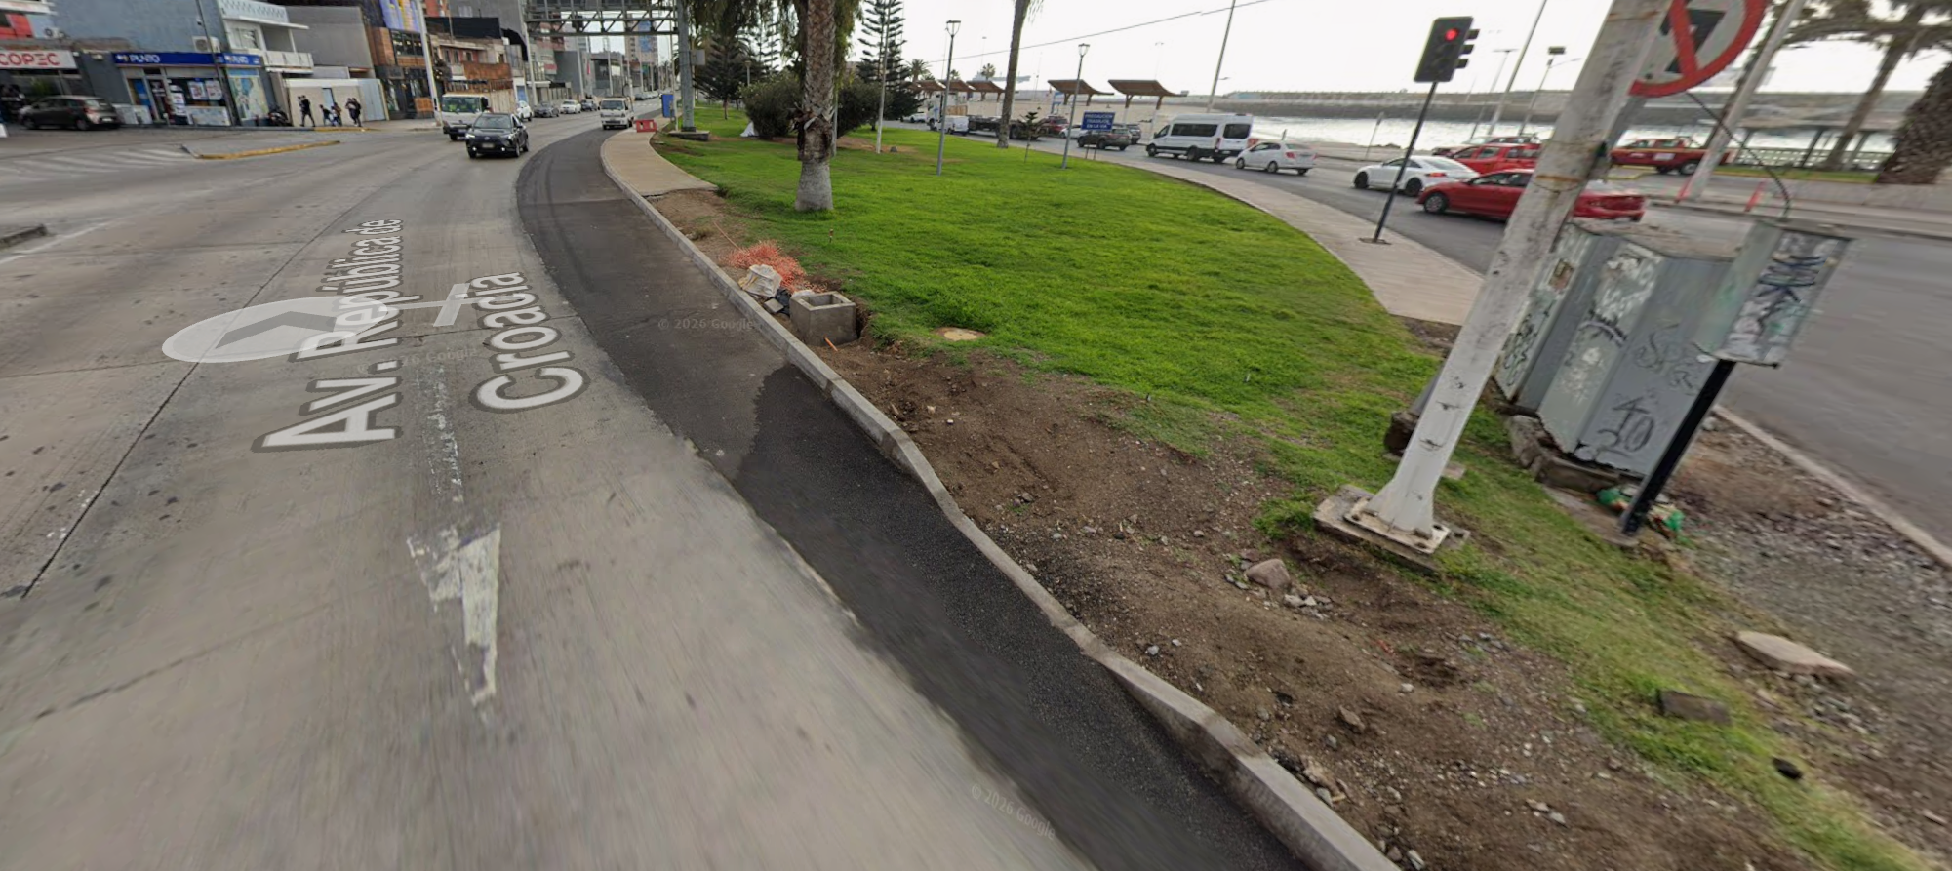
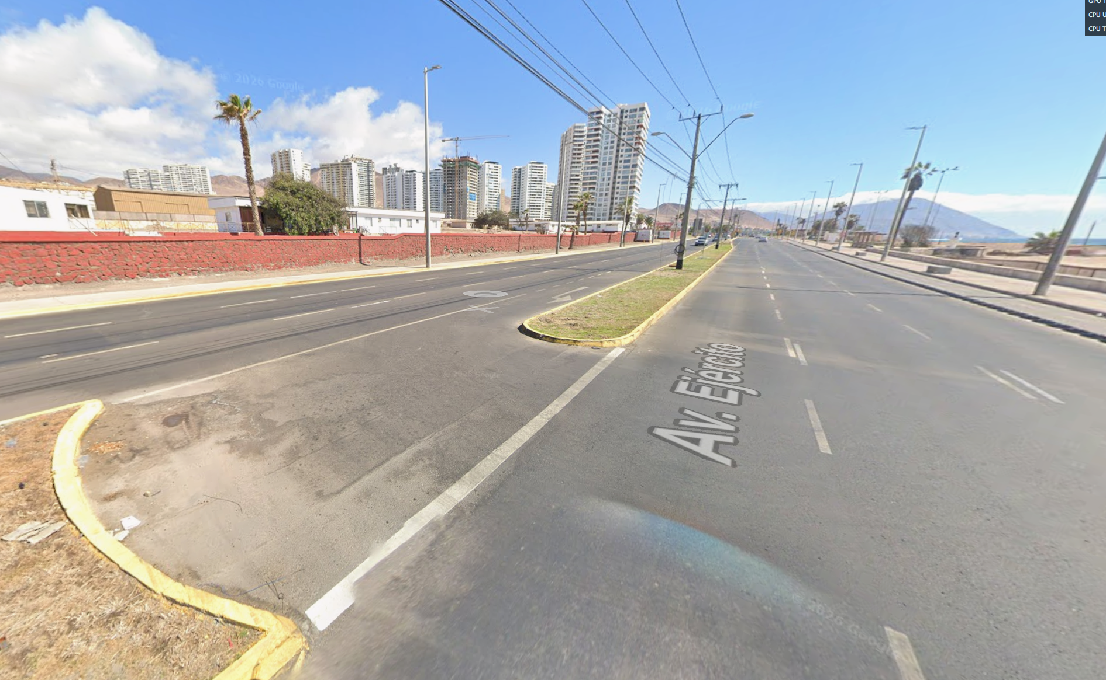
Bike Photos
Antofagasta
Source: Americas Triathlon NF Information Package — Antofagasta 4–5 Jul 2026

Slide 8
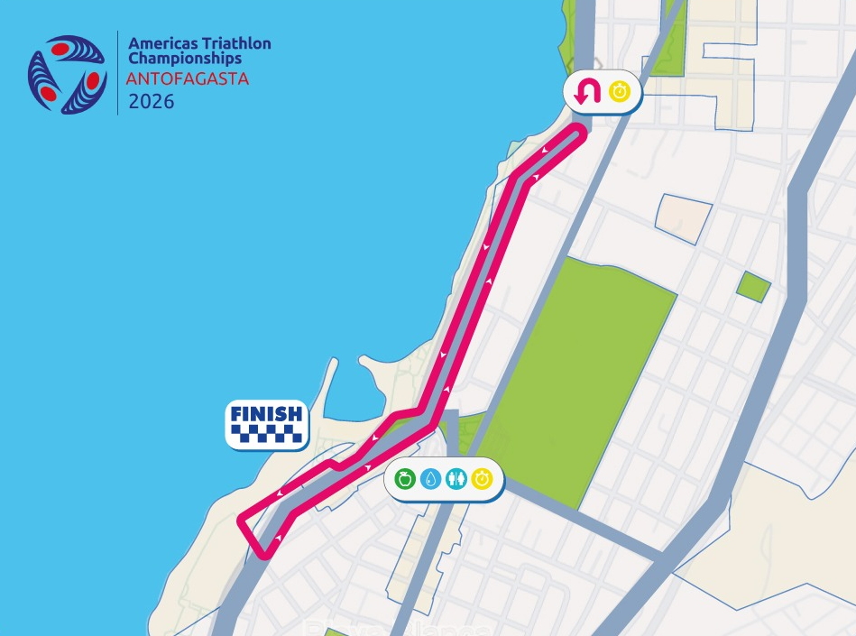
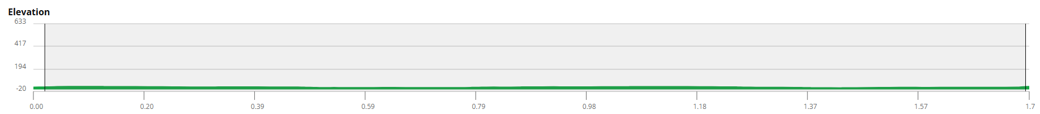
Run Course Profile
Antofagasta
10.0 km • 4 × 2.5 km
Asphalt — Av Grecia coastal road
Distance
Lap Structure
Total Climb
10.0 km
4 × 2.5 km
24 m (6m / lap)
[Drop run course map here] Save the organiser map as: ppt files/support/antofagasta_run_course.png It will be embedded automatically on the next run.
Avg Grade
Max ▲ / ▼
Heat Risk
0%
Not published
LOW
Tactical Notes
• Standard distance: 4 × 2.5 km laps along flat coastal road with wide, smooth asphalt
• Out-and-back to turnaround at intersection
• Cool winter temperatures (~13–18 °C) promote aggressive run pacing
Source: Americas Triathlon NF Information Package — Antofagasta 4–5 Jul 2026
Not in race brief: Elevation profile (course is flat coastal road; no published grade data)

Slide 9
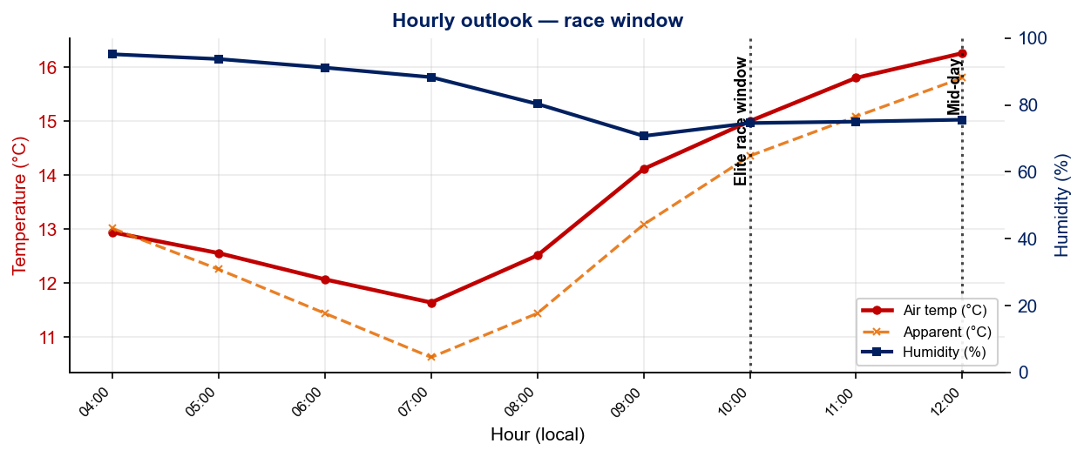
Race-Day Weather Outlook
Antofagasta
2026-07-04 • Historical climatology — same calendar day, 7-year mean
Elite race window — 10:00
Temperature
Apparent / Heat
Humidity
15.7 °C
15.1 °C
75%
Wind
UV peak
Heat Stress
7.4 km/h
—
LOW
Mid-day — 12:00
Temperature
Apparent / Heat
Humidity
16.3 °C
15.8 °C
76%
Wind
UV peak
Heat Stress
9.4 km/h
—
LOW
Hydration & Cooling Cues
• Cool to mild outlook. Standard fluid plan and no special pre-cooling required
• Cold air pre-race — extended warm-up + warm clothing to lounge. Parka for staying warm after warmup and during introductions can offer a lfit
Data source: Open-Meteo. Forecast will replace climatology once race day is within 16 days. Historical Race Conditions slide shows what actually happened in prior years.

Slide 10
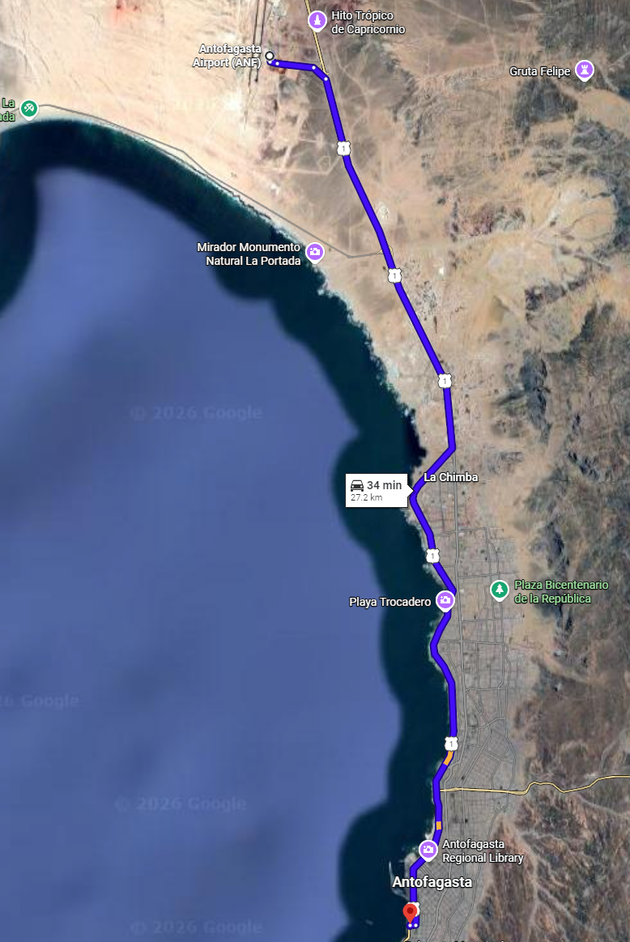
Travel & Arrival Load
Denver, CO → Antofagasta race week
Core travel read
No direct US → Antofagasta flights. Every itinerary connects through Santiago de Chile (SCL). Cleanest route: Denver → SCL (overnight via DFW / IAH / MIA / ATL), then a 2-hour domestic hop SCL → ANF on LATAM, SKY, or JetSMART. Total door-to-door is typically 18–22 h with a layover in Santiago. Only +2 h time-zone shift from Denver to Chile (CLT, UTC-4), so jet-lag impact is minimal, but the long overnight leg warrants an extra recovery day.
Primary route
Flight time
Time zones
Airport Transfer
Transfer Distance
DEN → SCL → ANF
~14 – 16 h
+2h
WT Sponsored
~25 min by car
2-stop itinerary
Plus SCL layover
Chile ahead of Denver
LOC-recommended / taxi
Andrés Sabella → Av Angamos
Host Hotel / Official Accommodation Read
• Official hotel: ENJOY ANTOFAGASTA, Av Angamos 1455. +56 5 5265 3000.
• Alternates (all close to venue): Holiday Inn Express. Location for USA Men’s Group
• ENJOY is also the official briefing venue (Elite, Para, Youth, AG
Food / Grocery Options Near Hotel + Venue
• Supermarkets Brands: Líder / Jumbo / Unimarc supermarkets in central Antofagasta; Pharmacies (Cruz Verde / Salcobrand).
• Hydration note: bottled / filtered water only/ Antofagasta tap water is desalinated but variable; stick to sealed bottles for race week to remove GI risk.
• Cool-weather kit: pack warm layers + windbreaker. July is winter; mornings can be 12–13 °C with ocean breeze.

Slide 11
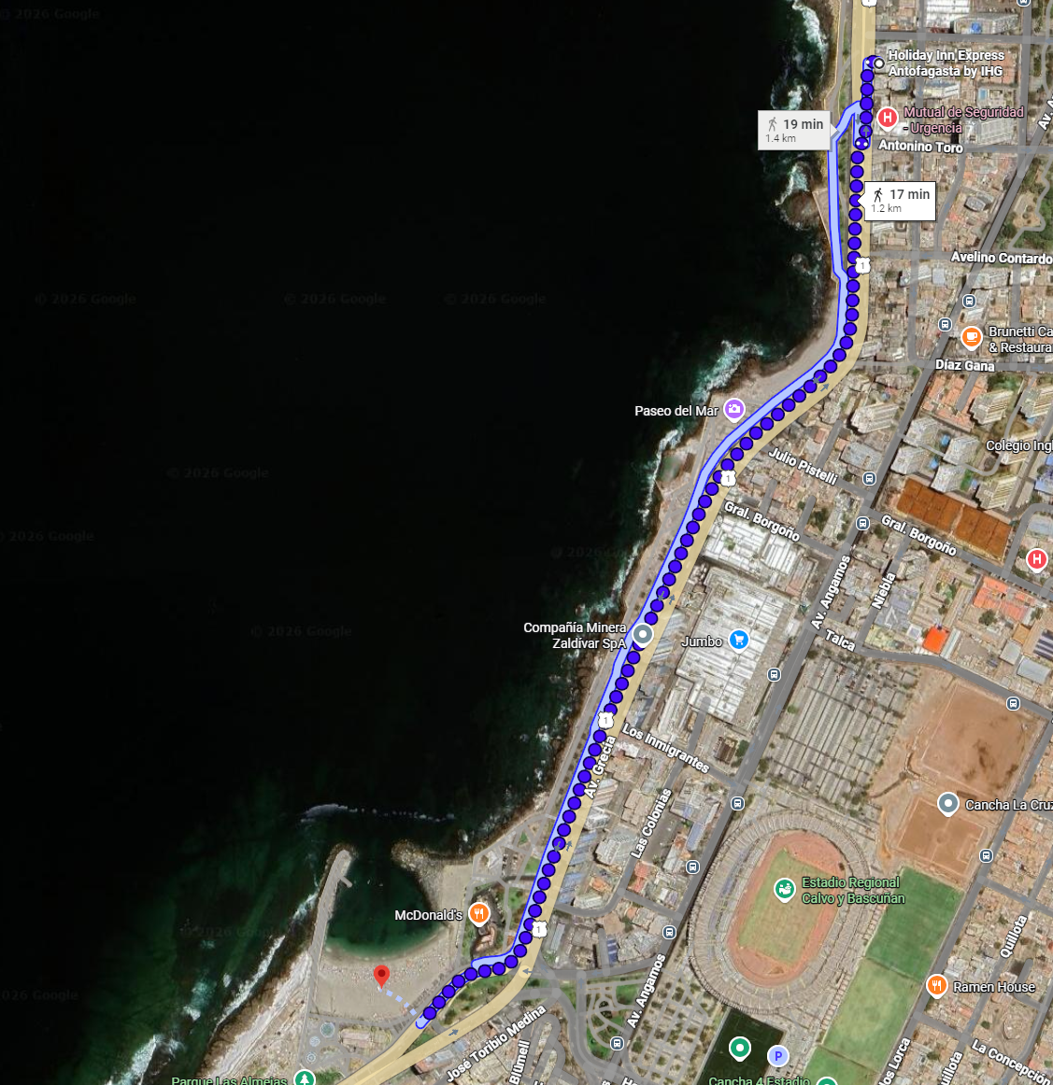
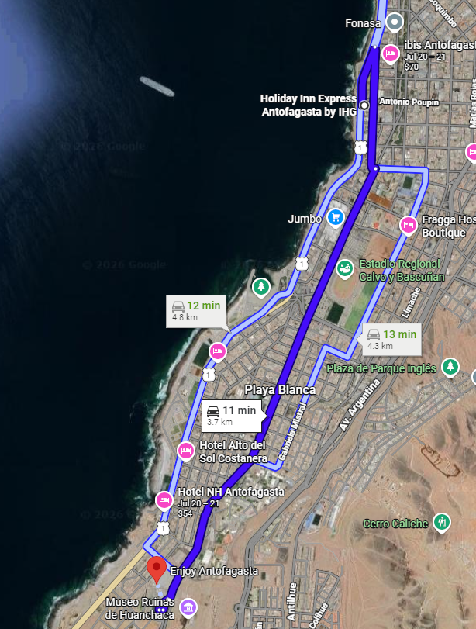
Accommodation and Training
Antofagasta
Groceries
Week Training Guide
Assumes Holiday Inn Accomodation
• Distance from Holiday Inn to BEACH START – 1.4km or ~20 min walk
[Drop run course map here] Save the organiser map as: ppt files/support/antofagasta_run_course.png It will be embedded automatically on the next run.
• Distance from Holiday Inn to OLYMPIC TRAINING POOL – 1.1km or ~17 min walk
• Distance from Holiday Inn to supermarket UNIMARC – 250 meters or 5 min walk
• UBER Operates in Antofagasta at low prices making allowing for cheap 10 min drives to the racecourse and the training pool.
Pool Location
Tactical Notes
• Race Briefing held at ENJOY Antofagasta, 3km from the Holiday Inn. Short 10-15 min drive through the center of town.
Source: Americas Triathlon NF Information Package — Antofagasta 4–5 Jul 2026

Slide 12
Who to Watch — Antofagasta Race Week
ELITE MEN
ELITE WOMEN
Top 10 Ranked on Startlist
Top 10 Ranked on Startlist
Rank | Athlete | Points
2 | Miguel Hidalgo | 6,703
18 | Diego Moya | 2,904
33 | Manoel Messias | 2,439
41 | Mathis Beaulieu | 2,213
48 | Reese Vannerson | 2,139
53 | Martin Sobey | 2,065
57 | Liam Donnelly | 2,023
60 | Braxton Legg | 2,018
77 | Sullivan Middaugh | 1,726
89 | Blake Bullard | 1,607
Rank | Athlete | Points
30 | Maria Carolina Velasquez Soto | 2,471
31 | Djenyfer Arnold | 2,458
36 | Rosa Maria Tapia Vidal | 2,340
50 | Danielle Orie | 1,988
56 | Ana Maria Valentina Torres Gomez | 1,878
57 | Kelly Wetteland | 1,840
69 | Naomi Ruff | 1,682
73 | Rosa Elena Martinez Melchior | 1,639
77 | Giovanna Lacerda | 1,595
89 | Joy Gill | 1,479
Returning Podium Athletes on Startlist
Returning Podium Athletes on Startlist
No prior race history at this venue.
No prior race history at this venue.
Rankings = latest local database snapshot. Updated weekly

Slide 13
Top Swim Threats
Antofagasta
Ranked by EWMA swim features from the elite prediction model • Front Pack % → Avg Gap → EWMA split • Distance: Standard
ELITE MEN
ELITE WOMEN
# | Athlete | Lead Pack % | Avg Gap (s) | EWMA Swim | Races
1 | Chase McQueen | 50% | +7.3 | 18:05 | 22
2 | Ramón Armando Matute | 50% | +8.2 | 18:28 | 5
3 | Kauê Willy | 36% | +15.8 | 18:42 | 11
4 | Chris Gregor | 33% | +25.7 | 18:31 | 4
5 | Diego Moya | 30% | +12.6 | 17:52 | 20
6 | Yhousman David Perdomo Peña | 29% | +17.7 | 18:59 | 8
7 | Alvaro Campos Solano | 18% | +21.3 | 19:09 | 10
# | Athlete | Lead Pack % | Avg Gap (s) | EWMA Swim | Races
1 | Caroline Theil | 100% | +0.0 | 19:51 | 2
2 | Eleanor Beveridge | 100% | +0.0 | 20:36 | 2
3 | Vittoria Lopes | 62% | +5.6 | 19:29 | 22
4 | Moira Miranda | 43% | +16.3 | 19:23 | 7
5 | Macarena Salazar | 31% | +30.3 | 21:01 | 16
6 | Leslie Amat Alvarez | 30% | +21.6 | 20:29 | 17
7 | Paula Vega | 25% | +17.5 | 20:13 | 2
U23 MEN
U23 WOMEN
# | Athlete | Lead Pack % | Avg Gap (s) | EWMA Swim | Races
1 | Blake Bullard | 67% | +5.9 | 17:48 | 1
2 | David Vega Campoverde | 50% | +4.5 | 20:01 | 1
3 | Nicolas Probert Vargas | 33% | +12.3 | 18:12 | 2
4 | Dixon Hernandez | 33% | +20.2 | 9:22 | 3
5 | João Vitor Mazorca | 20% | +23.2 | 9:55 | 7
6 | Daniel Ubilla Sabada | 12% | +23.2 | 9:32 | 11
7 | Alfredo Miguel Rodríguez Figueroa | 0% | +10.5 | 18:53 | 1
# | Athlete | Lead Pack % | Avg Gap (s) | EWMA Swim | Races
1 | Sidney Clement | 33% | +15.0 | 20:06 | 1
2 | Kelly Wetteland | 20% | +12.0 | 20:02 | 1
3 | Yaniuska Mared Jimenez Arriechi | 14% | +36.6 | 11:25 | 5
4 | Alexandra Campbell | 10% | +26.1 | 10:20 | 10
5 | Jimena Renata De La Peña Schott | 9% | +21.8 | 10:21 | 16
6 | Shelby Lajeunesse | 8% | +31.0 | 10:24 | 10
7 | Maria De Los Angeles Bonilla Garcia | 7% | +28.0 | 7:51 | 14

Slide 14
USA World Rankings Snapshot
Antofagasta
As of 2026-06-22 • World Triathlon Rankings • Heading into Antofagasta • Race tier: Continental Championships
Max Points Available at this Race
Win
Podium
Top 5
Top 10
Top 15
Top 20
590 pts
464 pts
363 pts
234 pts
158 pts
107 pts
ELITE MEN
ELITE WOMEN
Rank | Athlete | Points | Curr | Prev
15 | John Reed | 3,185 | 6 | 6
48 | Reese Vannerson | 2,140 | 6 | 6
56 | Morgan Pearson | 2,026 | 4 | 5
60 | Braxton Legg | 2,019 | 6 | 6
73 | Seth Rider | 1,759 | 6 | 4
79 | Sullivan Middaugh | 1,727 | 6 | 6
88 | Chase McQueen | 1,635 | 6 | 6
94 | Blake Bullard | 1,608 | 6 | 6
100 | Darr Smith | 1,545 | 6 | 6
108 | Keller Norland | 1,454 | 6 | 6
118 | Zach Leachman | 1,331 | 6 | 1
124 | Porter Middaugh | 1,295 | 6 | 4
Rank | Athlete | Points | Curr | Prev
7 | Taylor Spivey | 4,879 | 6 | 3
25 | Gwen Jorgensen | 2,675 | 6 | 6
26 | Gina Sereno | 2,667 | 5 | 6
46 | Erika Ackerlund | 2,101 | 5 | 6
50 | Danielle Orie | 2,001 | 6 | 6
59 | Kelly Wetteland | 1,841 | 6 | 3
71 | Naomi Ruff | 1,683 | 6 | 6
84 | Kirsten Kasper | 1,552 | 5 | 2
91 | Joy Gill | 1,480 | 6 | 3
96 | Eleanor Beveridge | 1,406 | 6 | 6
99 | Michelle Magnani | 1,365 | 6 | 6
112 | Rachel Werking | 1,254 | 6 | 1
141 | Ellison Wolfe | 1,085 | 6 | 2
150 | Katie McCune | 1,043 | 6 | 1
157 | Taylor Knibb | 1,003 | 2 | 1
160 | Jimena Renata De La Peña Schott | 1,000 | 6 | 5

Slide 15
Olympic Qualification Pace
Antofagasta
Paris 2024 OQR cutoff (30th): 3,626.69 pts ÷ 12-event cap = 302 pts / event on pace
An athlete who averages ~302 pts per event across their best 12 events is on pace to clear the LA 2028 qualifying threshold.
FINISH POSITION AT EACH TIER THAT HITS 302-PT PACE
Tier | Win pts | Last on-pace pos | First off-pace pos (pts) | Verdict
World Championship Series | 1000 | #16 | #17 (287 pts) | Top 16
World Cup | 500 | #7 | #8 (290 pts) | Top 7
Continental Championships (Americas) | 590 | #6 | #7 (296 pts) | Top 6
Continental Cup (Americas) | 280 | None (win = 280) | — | Not achievable
USA MEN
USA WOMEN
Rk | Athlete | Total | Races | On | Off | Pace | Proj @12
21 | John Reed | 579 | 1 | 1 | 0 | 579 | 6,953
24 | Seth Rider | 535 | 2 | 1 | 1 | 267 | 3,209
29 | Sullivan Middaugh | 462 | 1 | 1 | 0 | 462 | 5,550
34 | Reese Vannerson | 396 | 1 | 1 | 0 | 396 | 4,749
43 | Braxton Legg | 313 | 1 | 1 | 0 | 313 | 3,758
58 | Zach Leachman | 212 | 1 | 0 | 1 | 212 | 2,545
63 | Chase McQueen | 180 | 1 | 0 | 1 | 180 | 2,159
72 | Blake Bullard | 144 | 1 | 0 | 1 | 144 | 1,724
115 | Darr Smith | 38 | 1 | 0 | 1 | 38 | 454
Rk | Athlete | Total | Races | On | Off | Pace | Proj @12
14 | Gina Sereno | 704 | 2 | 1 | 1 | 352 | 4,226
19 | Taylor Spivey | 579 | 1 | 1 | 0 | 579 | 6,953
24 | Gwen Jorgensen | 496 | 1 | 1 | 0 | 496 | 5,949
25 | Kelly Wetteland | 462 | 1 | 1 | 0 | 462 | 5,550
26 | Taylor Knibb | 459 | 1 | 1 | 0 | 459 | 5,503
49 | Eleanor Beveridge | 248 | 1 | 0 | 1 | 248 | 2,975
60 | Danielle Orie | 195 | 2 | 0 | 2 | 98 | 1,171
63 | Rachel Werking | 181 | 1 | 0 | 1 | 181 | 2,178
64 | Joy Gill | 168 | 1 | 0 | 1 | 168 | 2,014
78 | Kirsten Kasper | 113 | 1 | 0 | 1 | 113 | 1,353
93 | Michelle Magnani | 71 | 1 | 0 | 1 | 71 | 855
Rk | Athlete | Total | Races | On | Off | Pace | Proj @12
22 | John Reed | 579 | 1 | 1 | 0 | 579 | 6,953
26 | Seth Rider | 535 | 2 | 1 | 1 | 267 | 3,209
31 | Sullivan Middaugh | 462 | 1 | 1 | 0 | 462 | 5,550
34 | Chase McQueen | 448 | 2 | 0 | 2 | 224 | 2,688
38 | Reese Vannerson | 396 | 1 | 1 | 0 | 396 | 4,749
54 | Braxton Legg | 313 | 1 | 1 | 0 | 313 | 3,758
70 | Zach Leachman | 212 | 1 | 0 | 1 | 212 | 2,545
85 | Blake Bullard | 144 | 1 | 0 | 1 | 144 | 1,724
109 | Carter Stuhlmacher | 71 | 1 | 0 | 1 | 71 | 855
133 | Darr Smith | 38 | 1 | 0 | 1 | 38 | 454
Rk | Athlete | Total | Races | On | Off | Pace | Proj @12
11 | Taylor Knibb | 921 | 2 | 2 | 0 | 461 | 5,526
15 | Gina Sereno | 704 | 2 | 1 | 1 | 352 | 4,226
20 | Taylor Spivey | 579 | 1 | 1 | 0 | 579 | 6,953
22 | Danielle Orie | 561 | 3 | 1 | 2 | 187 | 2,245
29 | Gwen Jorgensen | 496 | 1 | 1 | 0 | 496 | 5,949
32 | Kelly Wetteland | 462 | 1 | 1 | 0 | 462 | 5,550
60 | Eleanor Beveridge | 248 | 1 | 0 | 1 | 248 | 2,975
79 | Rachel Werking | 181 | 1 | 0 | 1 | 181 | 2,178
81 | Joy Gill | 168 | 1 | 0 | 1 | 168 | 2,014
91 | Kirsten Kasper | 113 | 1 | 0 | 1 | 113 | 1,353
103 | Michelle Magnani | 71 | 1 | 0 | 1 | 71 | 855
Current early-cycle rank-30 line: Men #30: Jawad Abdelmoula = 496 pts ΓÇó Women #30: Noelia Juan = 494 pts (low because LA 2028 cycle is just opening ΓÇö Paris cutoff 3,627 pts is the 3-year benchmark) On-pace = events scoring ΓëÑ302 pts. Off-pace = events <302 pts. Pace = total breakdown pts ├╖ events raced. Proj @12 = pace ├ù 12-event cap (green if ΓëÑ Paris cutoff).

Slide 16
USA Olympic Qualification Snapshot
Antofagasta
As of Week 2026-06-28 • Olympic Qualification Rankings (LA 2028 cycle) • Heading into Antofagasta
ELITE MEN
ELITE WOMEN
Rank | Athlete | Points | Second | First
22 | John Reed | 579 | 0 | 1
26 | Seth Rider | 535 | 0 | 2
31 | Sullivan Middaugh | 462 | 0 | 1
34 | Chase McQueen | 448 | 0 | 2
38 | Reese Vannerson | 396 | 0 | 1
54 | Braxton Legg | 313 | 0 | 1
70 | Zach Leachman | 212 | 0 | 1
85 | Blake Bullard | 144 | 0 | 1
109 | Carter Stuhlmacher | 71 | 0 | 1
133 | Darr Smith | 38 | 0 | 1
Rank | Athlete | Points | Second | First
11 | Taylor Knibb | 921 | 0 | 2
15 | Gina Sereno | 704 | 0 | 2
20 | Taylor Spivey | 579 | 0 | 1
22 | Danielle Orie | 561 | 0 | 3
29 | Gwen Jorgensen | 496 | 0 | 1
32 | Kelly Wetteland | 462 | 0 | 1
60 | Eleanor Beveridge | 248 | 0 | 1
79 | Rachel Werking | 181 | 0 | 1
81 | Joy Gill | 168 | 0 | 1
91 | Kirsten Kasper | 113 | 0 | 1
103 | Michelle Magnani | 71 | 0 | 1
Rankings: Latest weekly snapshot. Curr / Prev = events scoring in Year 2 vs Year 1 of the LA 2028 OQR cycle (results show as Period 'First' in the per-race breakdown). All current results are in Year 1 because we are still inside the first year of the qualifying window, so points appear under 'Prev'..

